Slide 1
Simple Neural Network for handwritten digit recognition
Gordon Gao
Carey Business School Professor

Slide 2
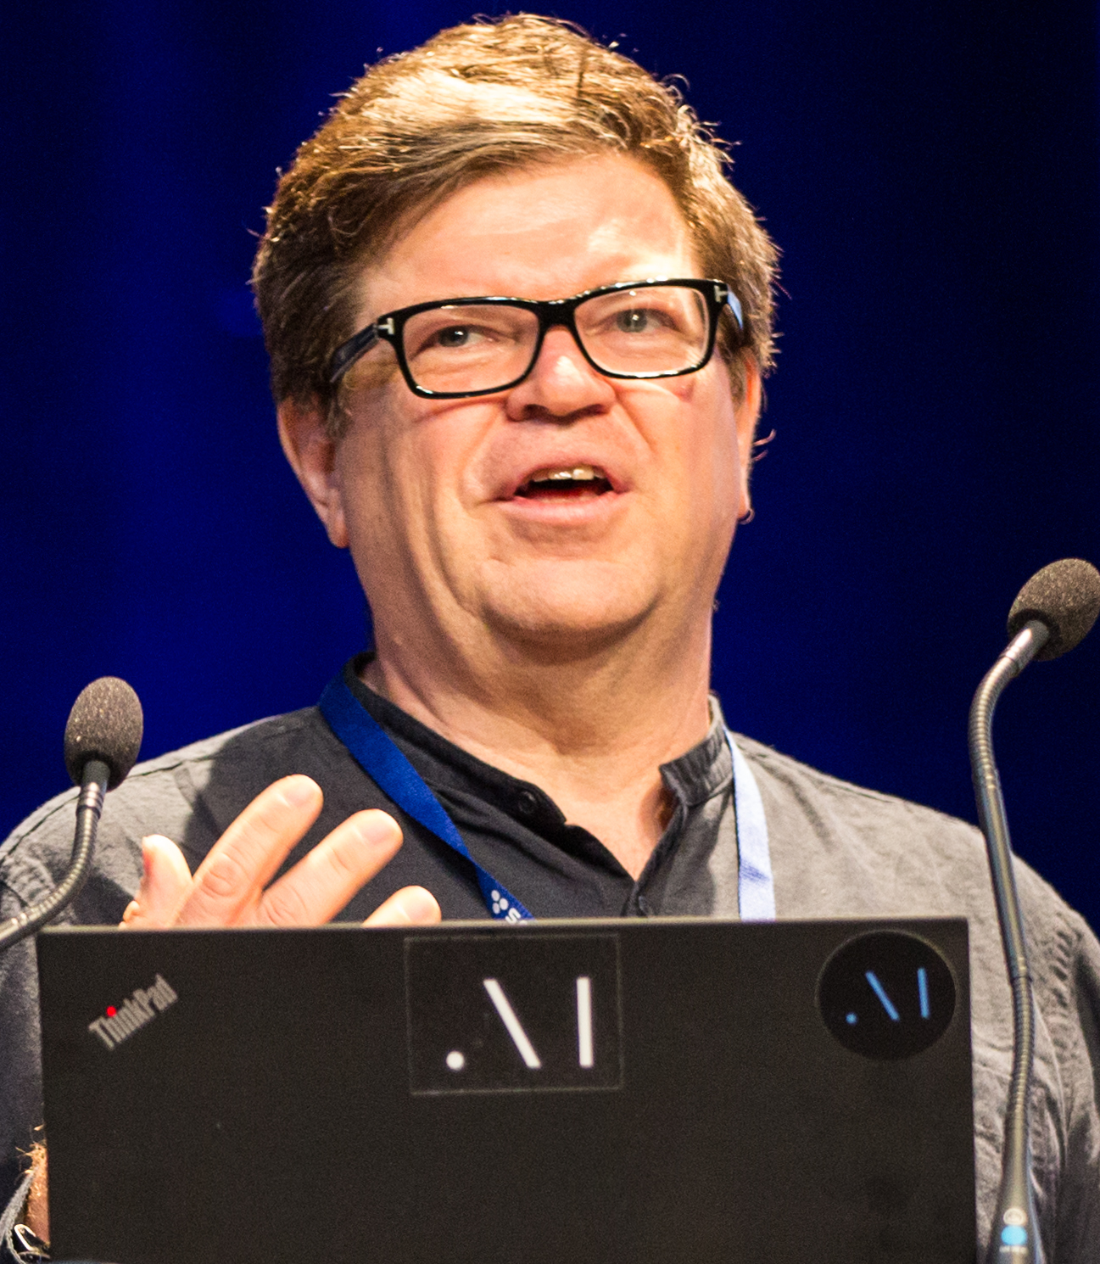
Recognizing the digits in handwriting
-Bank check recognition system is one of the most famous (or few) early successes of Neural Network
-Developed by Yann LeCun, then at AT&T Lab
-Now Professor of New York University and Chief AI Scientist at Facebook

Slide 3
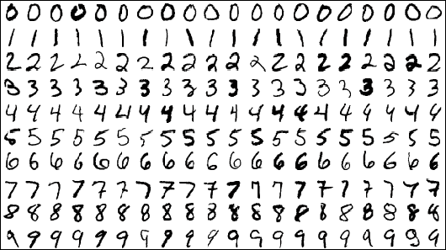
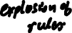
The Power of Deep Learning
Why the rules fails
Very hard to specify the rules
Why the traditional machine learning fails
features are hard to come up with
Deep Learning Shines!
No need for human to teach it -> it learns from data
No need for human to do feature engineering -> it learns from data

Slide 4
Files
Colab Notebook
Simple_NN_for_digits.ipynb
Python packages
TensorFlow: an open-source library/package for building neural net from Google
Keras: Python library/package for building neural network on top of Tensorflow
Data
MNIST handwritten digits
60,000 examples for training and 10,000 examples for testing

Slide 5
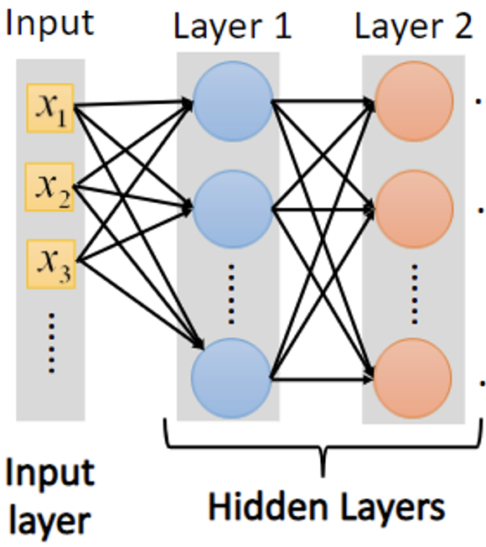
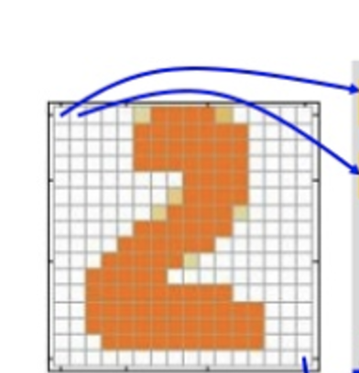
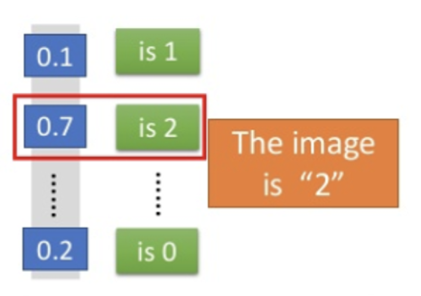
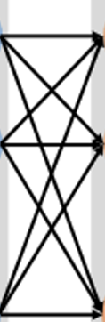
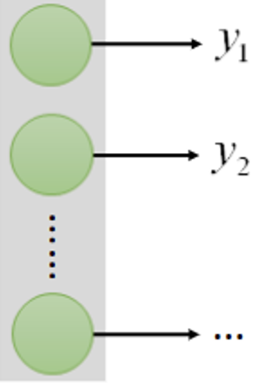
Network structure
Output
Pixels: 28 x 28 = 784
Output Layer

Slide 6
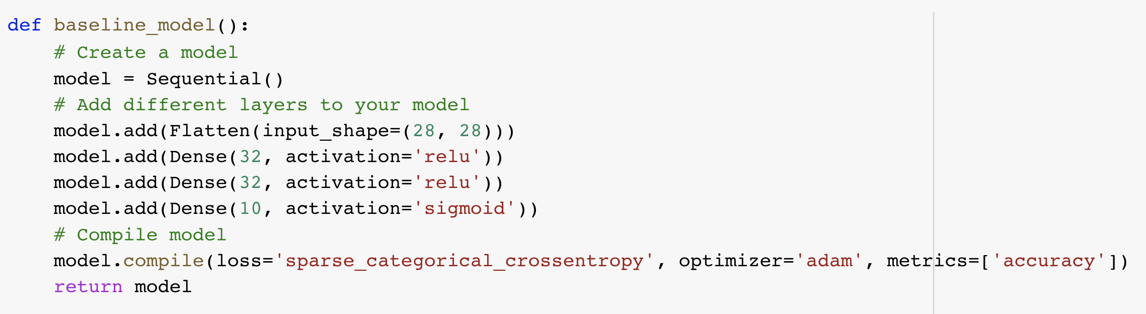
Build the neural network using Keras

Slide 7
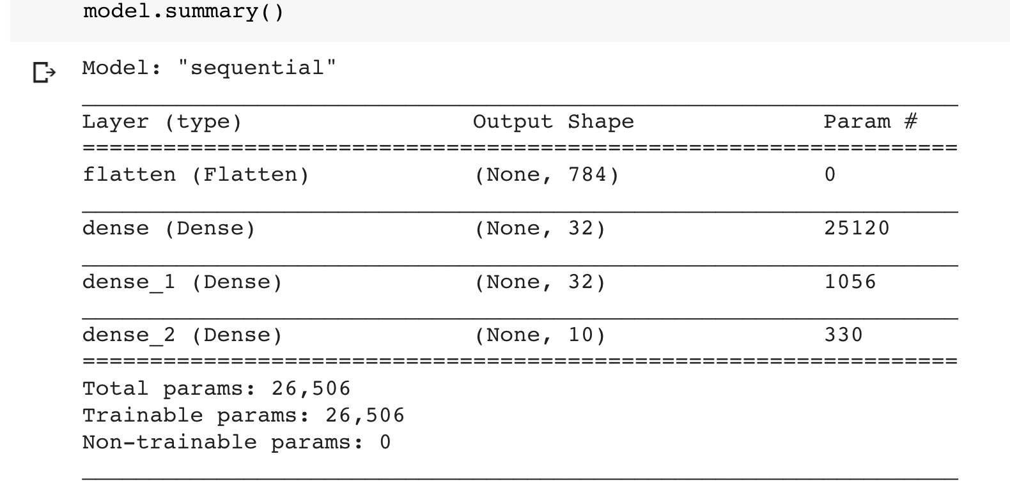
Model parameters
Weights (w): 784*32 = 25,088
biases (b): 32
Total = 25,088 + 32 = 25,120

Slide 8
Training process
Epoch 1
Output
Batch 1
Batch 2
Batch 3
…
Batch n
Forward propagation
-Compare with Labels
-Calculate the loss
Back propagation
Training Data
Output Layer

Slide 9
Training process
Epoch 1
Output
Batch 1
Batch 2
Batch 3
…
Batch n
Forward propagation
-Compare with Labels
-Calculate the loss
Back propagation
Training Data
Output Layer

Slide 10
Training process
Epoch 1
Output
Batch 1
Batch 2
Batch 3
…
Batch n
Forward propagation
-Compare with Labels
-Calculate the loss
Back propagation
Training Data
Output Layer

Slide 11
Training process
Epoch 2
Output
Batch 1
Batch 2
Batch 3
…
Batch n
Forward propagation
-Compare with Labels
-Calculate the loss
Back propagation
Training Data
Output Layer

Slide 12
Key takeaways
How Deep Learning works on tricky issues
Rules and feature engineering efforts are saved (yay!)
Build a neural network using Keras
Add layers of neurons
Define activation functions, loss function and optimizer
Calculate how many parameters to train in the model
Understand why deep learning needs more data (and loves more data)
Grasp the training process
Forward and back propagation
Batches and Epochs

Slide 13

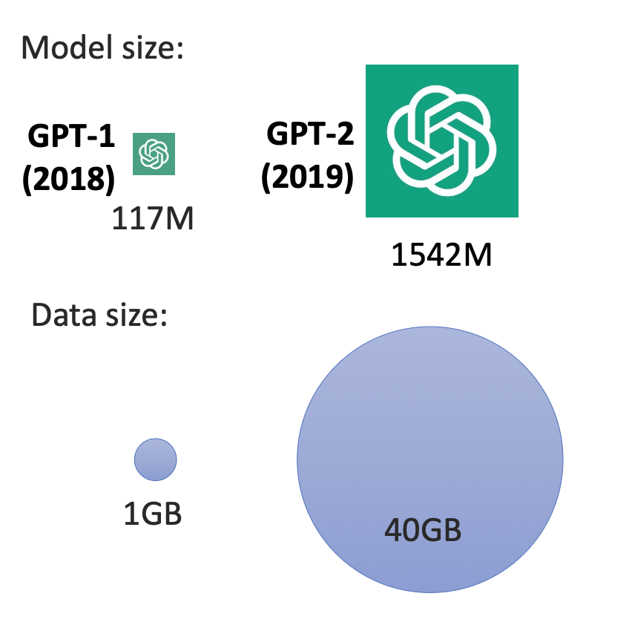
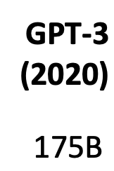
GPT Models before ChatGPT
45 TB

Slide 14
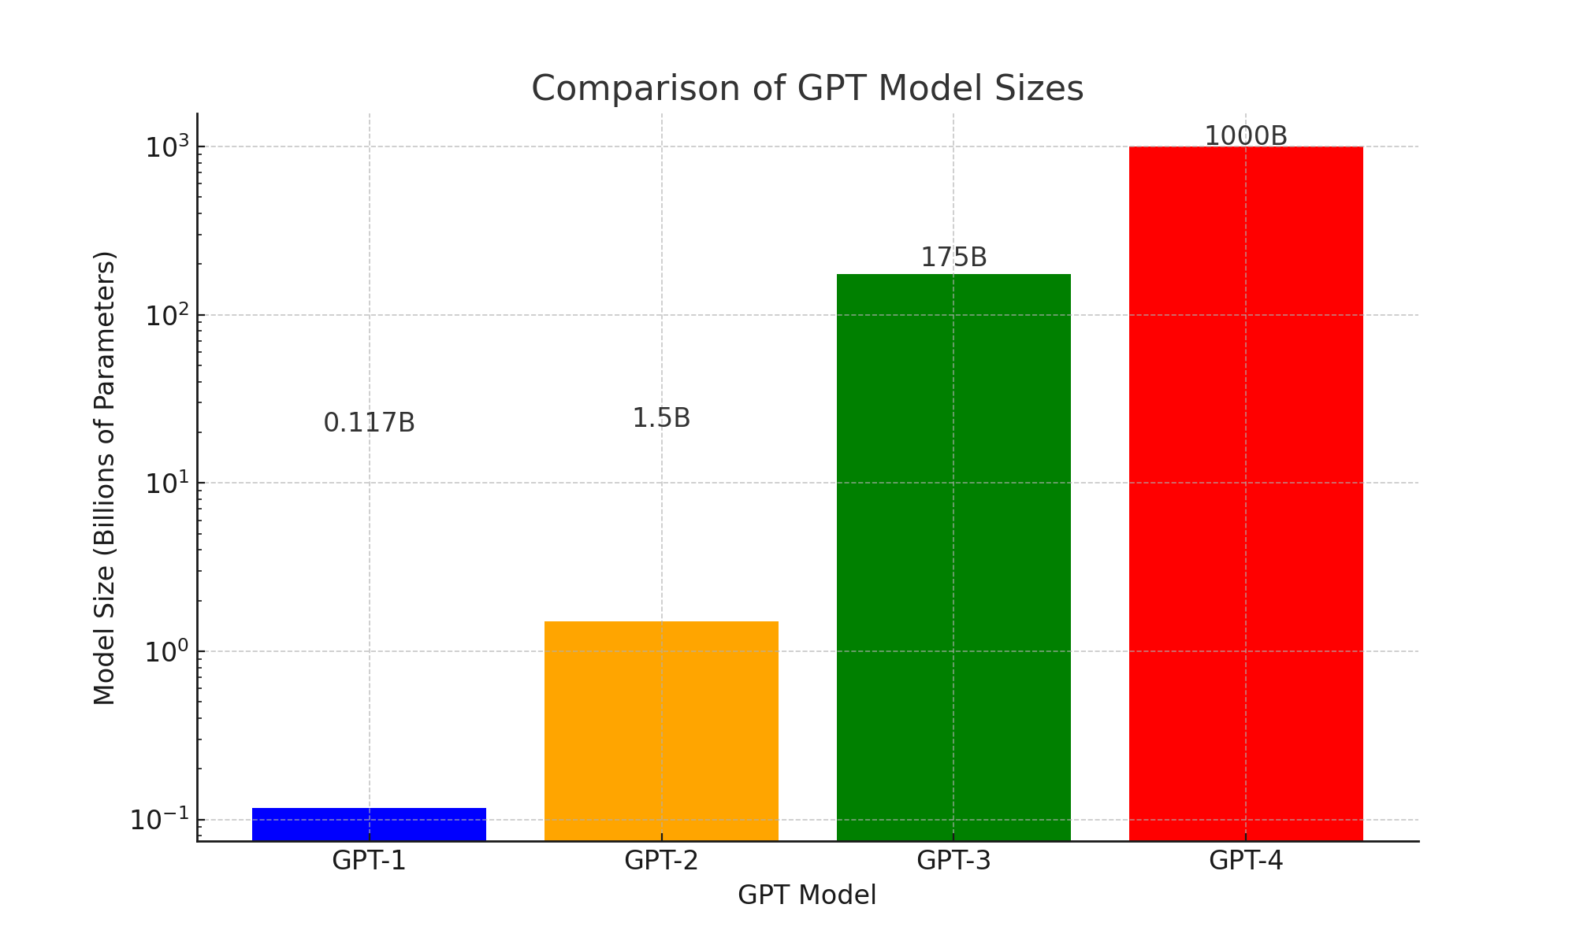
2018
2019
2020
2023

Slide 15
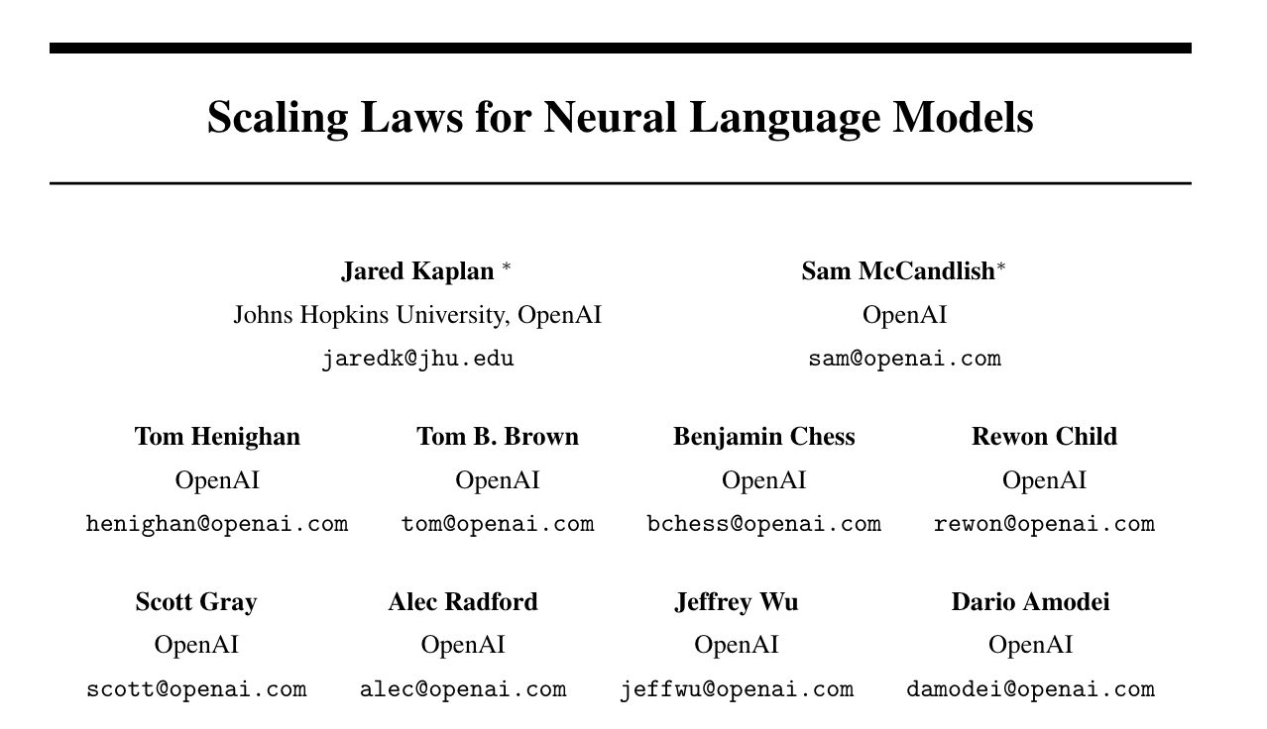
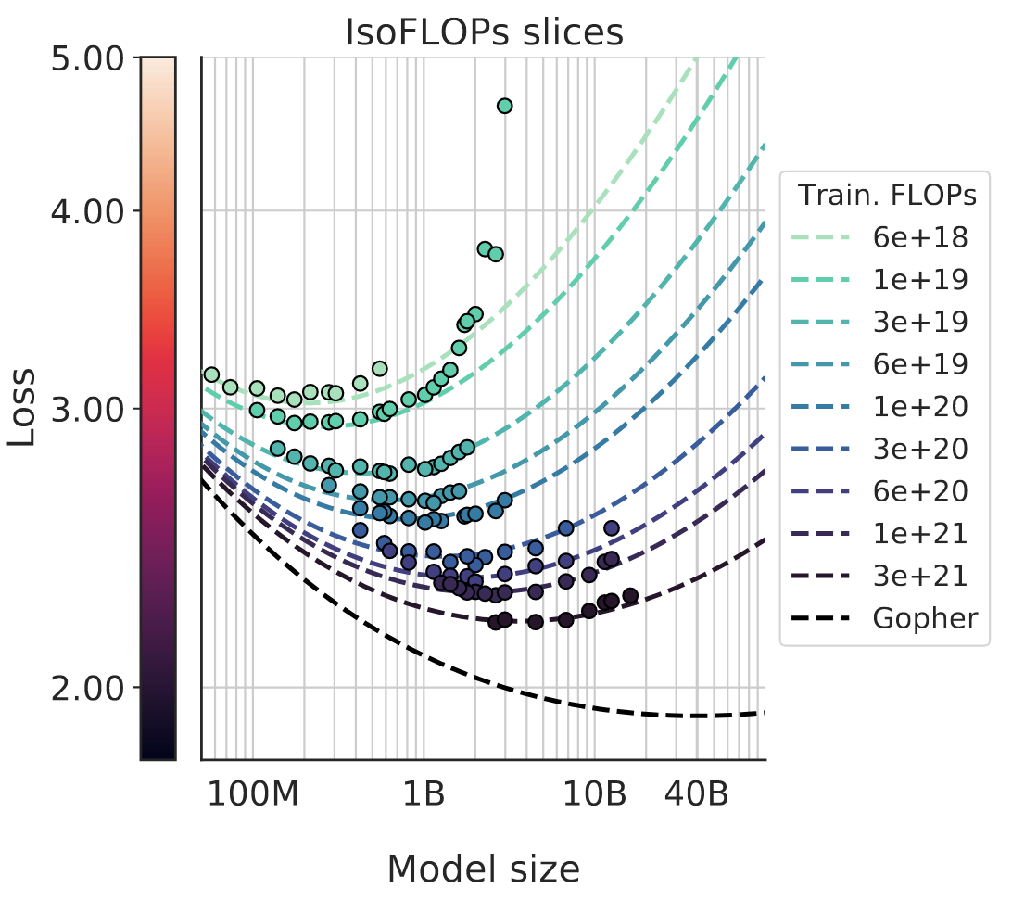
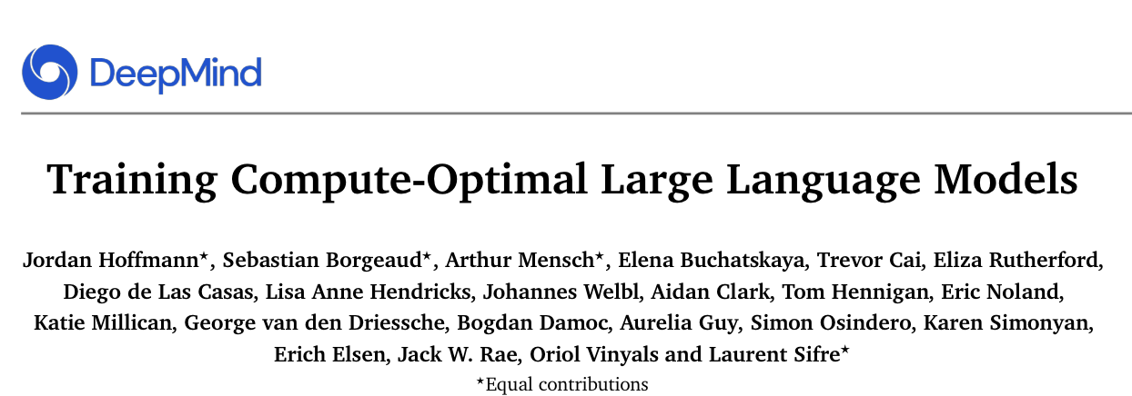
Scaling Laws
https://arxiv.org/pdf/2203.15556

Slide 16
Discussion
Will scaling laws hold?
Implications to business and society?

